Slide 1
OBJECT DETECTOR FOR VISUALLY IMPAIRED WITH DISTANCE CALCULATION FOR HUMANS
Using Raspberry Pi and Deep Learning
Dixitha Kasturi (160116737003)
Gouthami V (160116737005)
BATCH -103

Slide 2
CONTENT
Abstract
Problem Statement
Literature Survey
Methodology
Implementation
Results
Applications
Conclusion

Slide 3

ABSTRACT
Object detection is a computer vision technique for locating instances of objects in videos. When we as humans look at images or videos, we can recognize and locate objects within a matter of moments. The goal of this project is to replicate the intelligence of human in doing that using deep learning and raspberry pi with a camera. This model could be used for visually disabled people , robots, machines/vehicles for improved navigation and crash free motion.

Slide 4

PROBLEM STATEMENT
With the world moving towards automation, there’s a rising demand for an efficient Object detector especially for the visually impaired. This project focuses on integrating Deep learning algorithm with Raspberry Pi and Camera to detect the type of object and the approximate distance for humans efficiently with voice assistance.

Slide 5
LITERATURE SURVEY
Title | Authors | Problem Statement | Methodology | Limitations
You Only Look Once: Unified, Real-Time Object Detection | Joseph Redmon, Santosh Divvala, Ross Girshick, Ali Farhadi | An algorithm that has good speed in identifying objects efficiently is required. | This system divides the input image into an S × S grid. If the centre of an object falls into a grid cell, that grid cell is responsible for detecting that object. It tracks around 30 FPS | YOLO imposes spatial constraints on bounding box predictions since each grid cell only predicts two boxes and can only have one class.
Multistage Object Detection With Group Recursive Learning | Jianan Li , Xiaodan Liang, Jianshu Li , Yunchao Wei , Tingfa Xu , Jiashi | Most of the existing algorithms that implement object detection consider each image segment separately without taking into account the surrounding segments that decreases the accuracy of the predicted object. | Two strategies were adopted which would enhance the detection . 1.Group recursive learning. 2. Multi-Stage Cascaded network. | Difficulty in refining object proposals
A Practical Animal Detection And Collision Avoidance System Using Computer Vision Technique | Sachin Umesh Sharma and Dharmesh J. Shah | There are an endless number of accidents that take place on highways, everyday in India . Collision of an Animal with the vehicle is a big issue which leads to road accidents . To prevent that a low cost automatic animal detection system must be developed. | 1. Collecting data and setting up parameters. 2.Distance calculation of the detected animal. 3.Detecting the distance in terms of pixels and converting into meters | Animal radius was a constraint. (less than 2 meters)

Slide 6
METHODOLOGY
Dataset
Hardware Components
Proposed System
Algorithms with implementation

Slide 7
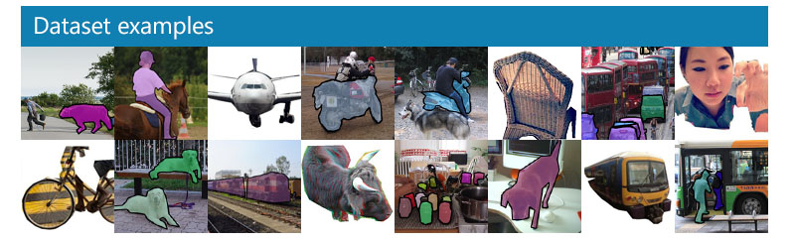
DATASET
The dataset used for the implementation of these algorithms is COCO(Common Objects in COntext) dataset
Contains 80 categories including all the common objects like person, cellphone, different kinds of vehicles and animals etc
Contains around 330,000 images

Slide 8
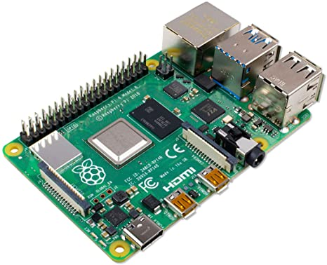
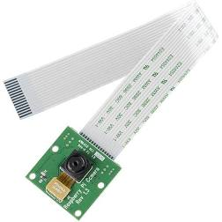
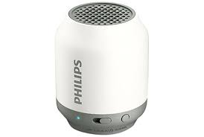
Raspberry Pi Monocular Camera module – 5MP
Speaker with Audio jack cable
Raspberry Pi 4 – 4GB RAM
Raspbian OS
HARDWARE COMPONENTS

Slide 9
PROPOSED SYSTEM OR DESIGN
Input Captured by Raspberry Pi Camera
Learning Specific Features
Generating Object Proposals
Refining Object Proposals(Confidence Scores) and Classifying object
Distance Calculation for Humans from Pi camera
Reading out class label(Object) and distance for humans using speaker

Slide 10
STEPS CATEGORIZATION
Step 1
Camera Interfacing with raspberry pi – Input Capturing
Step 2 – 4
Deep Learning Algorithm
Step 5
Distance Calculation
Step 6
Speaker interfacing with Raspberry pi to read out distance and class label.

Slide 11
STEP 1 : CAPTURING INPUT
At first, input is captured by the Raspberry Pi Camera module and is handled by the package provided by python called PiCamera.
Start_recording and stop_recording functions are used from the library to get the input and the captured input can be processed accordingly, eg: changing resolution, so that it becomes suitable for the Deep Learning algorithm which processes it further for prediction.
The input to Deep Learning algorithms are images which are extracted from the video captured by Pi using OpenCV. OpenCV breaks the given video into frames of images.

Slide 12
STEP 2 - 4 : ALGORITHM
Fast RCNN
YOLO
Comparison between Fast RCNN and YOLO
Implementation

Slide 13
Fast RCNN
The image is first processed with CNN to obtain feature maps.
Regional Proposal feature map is created for each regional proposal extract from the feature maps.
This Regional proposal feature map is resized to a fixed size with the help of a pooling layer called Region Of Interest(ROI) pooling layer
Feature vector is then obtained through the pooling layer and is passed to 2 fully connected layers:
Softmax Classification Layer: Class label is attached to the object in this layer
Bounding Box Regresser: Outputs bounding box coordinates for each output class

Slide 14
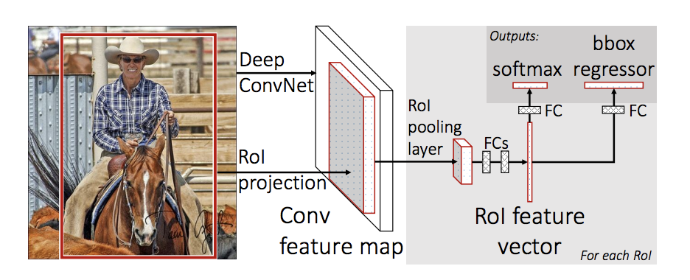

Slide 15

Fast RCNN
For RCNN, ReLU activation function was used
The rectified linear activation function is a piecewise linear function that will output the input directly if is positive, otherwise, it will output zero.

Slide 16
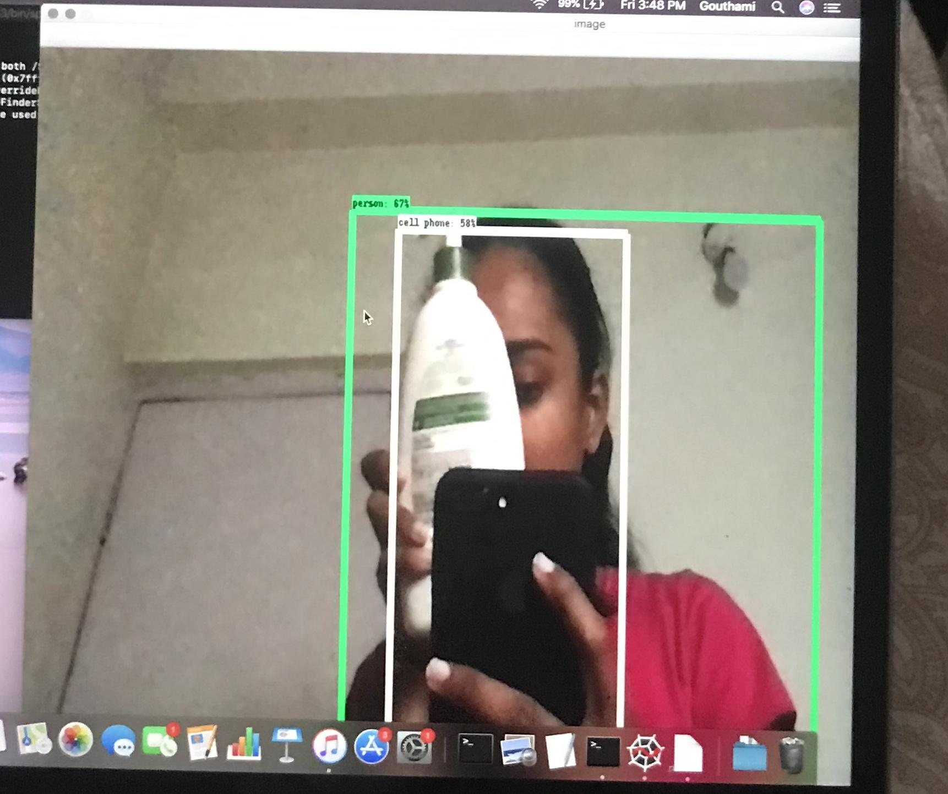
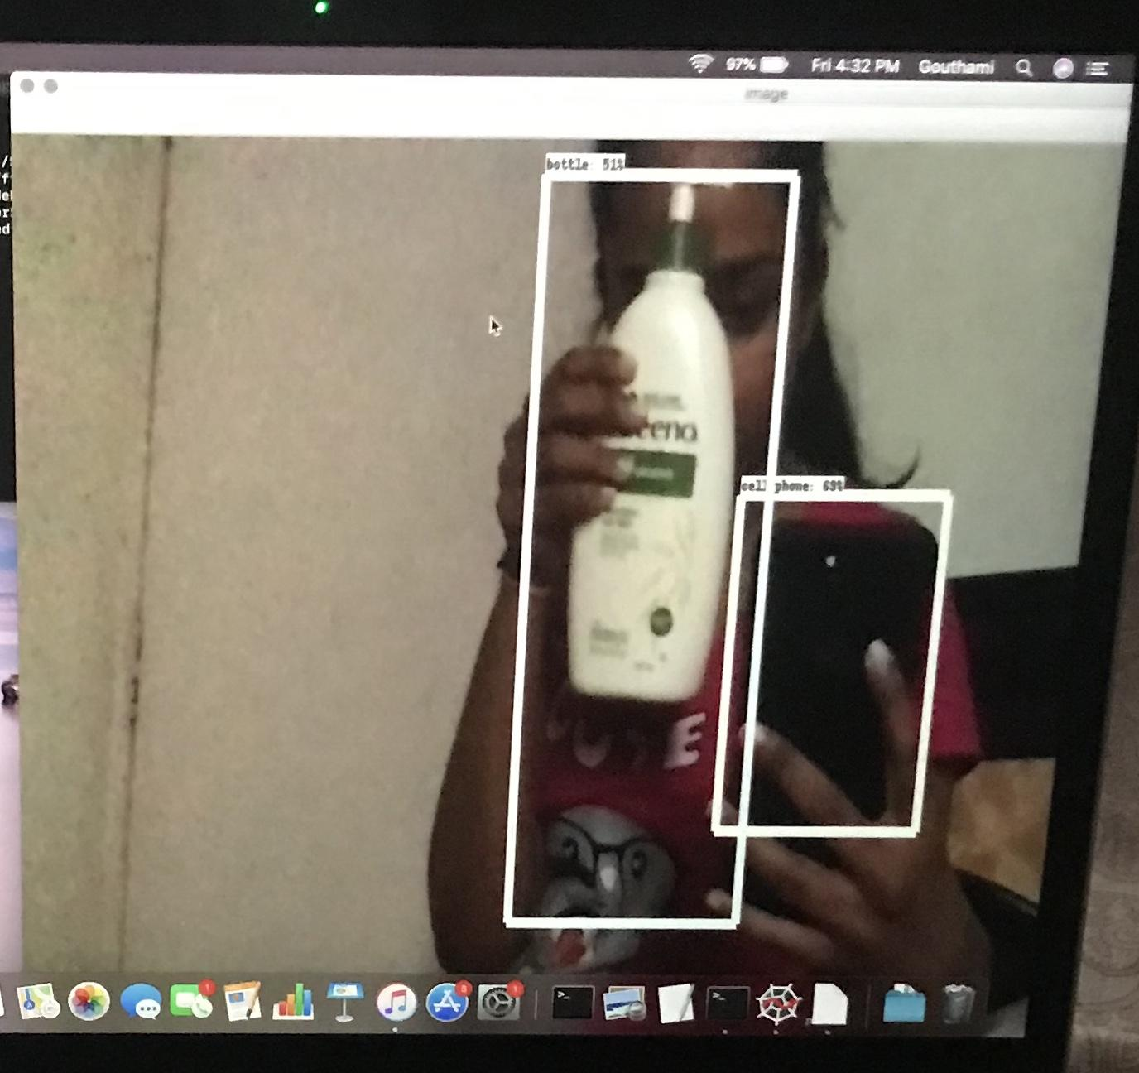
Limitations:
It is slow, takes a couple of seconds to predict
Can give wrong prediction at times
RESULTS

Slide 17
YOU ONLY LOOK ONCE
Algorithms like RCNN and fast RCNN perform detection on various region proposals and perform prediction multiple times for various regions in an image. Whereas in YOLO, the network does not look at the complete image. Instead, it looks at parts of the image which have high probabilities of containing the object.
In YOLO a single convolutional network predicts the bounding boxes and the class probabilities for these boxes.

Slide 18
Working of YOLO:
An image is split into SxS grid, within each of the grid m bounding boxes are taken.
For each of the bounding box, the network outputs a class probability and confidence scores values for the bounding box.
These confidence scores reflect how confident the model is that the box contains an object and how accurate the prediction is.
Each bounding box consists of 5 predictions: x, y, w, h, and confidence. The (x, y) coordinates represent the center of the box relative to the bounds of the grid cell.
The width and height are predicted relative to the whole image.
The bounding boxes having the class probability above a threshold value is selected and used to locate the object within the image.

Slide 19
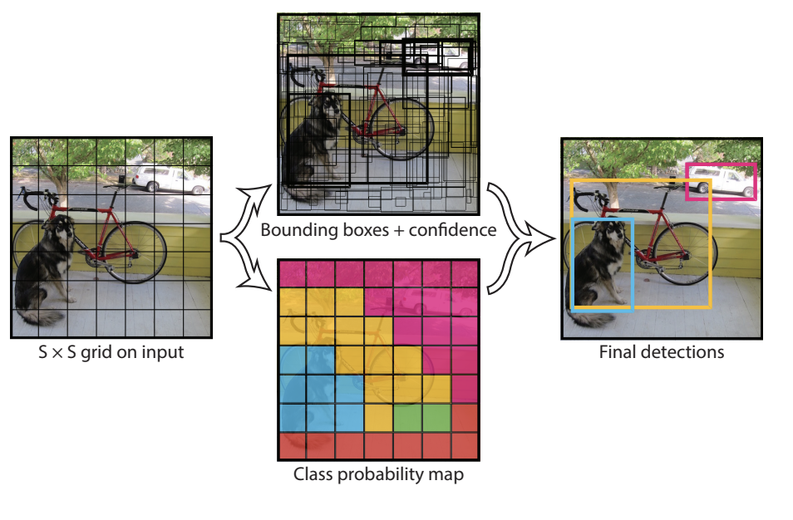

Slide 20
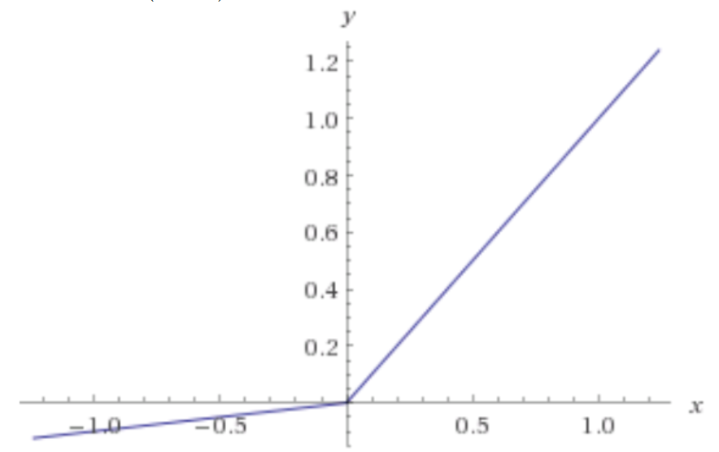
YOLO
The activation function used to develop this model is Leaky ReLU
Problem with ReLU is Dying ReLU problem
In ReLU, Neurons essentially die for all inputs and remain inactive no matter what input is supplied
No gradient flows and if large number of dead neurons are there in a Neural Network it’s performance is affected
Leaky ReLU corrects that problem by extending it’s range

Slide 21
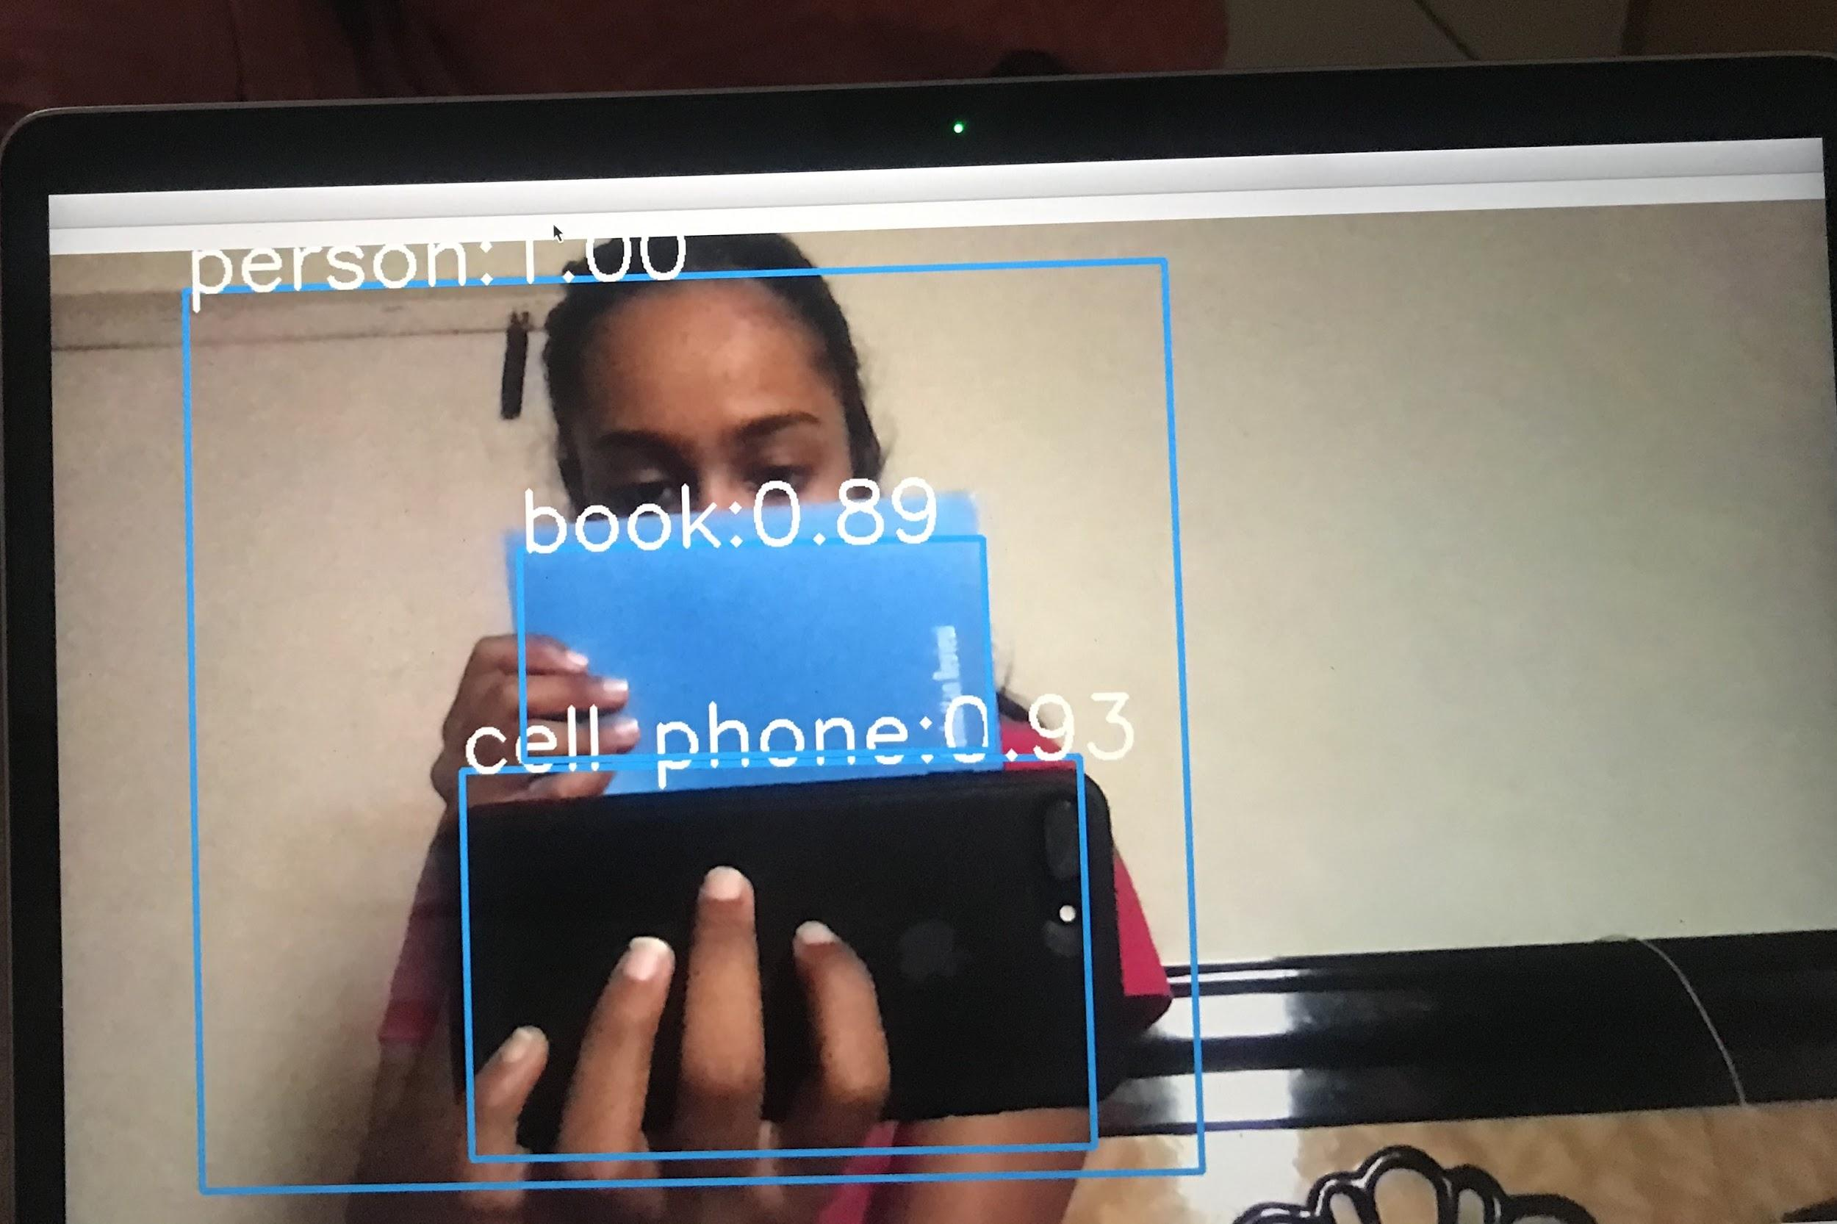
Advantages:
A lot faster than fast RCNN
Correct predictions with good accuracy
Works well with overlapped images
RESULTS

Slide 22
RCNN
YOLO
Advantage:
Faster RCNN generalizes well even when objects in the image show rare aspects of ratio. So, it detects small objects well with good amount of accuracy.
Limitation:
Faster RCNN is faster than a lot of other existing algorithms but still is slower than YOLO in processing the frames.
Advantages:
YOLO is a lot faster than other object detection algorithms. It has the capability to process 45 frames per second.
It makes classification and bounding box regression at the same time.
Limitation:
The limitation of YOLO algorithm is that it struggles with small objects within the image, for example it might have difficulties in detecting a flock of birds. This is due to the spatial constraints of the algorithm.

Slide 23
Step 5 : Distance Calculation
The distance calculation is done using Cascading Classifier, which uses xml files of contours
Haar Cascade classifiers : positive and negative images are used to train the classifier.
Positive images – These images contain the images which we want our classifier to identify.
Negative Images – Images of everything else, which do not contain the object we want to detect.
Haar Cascade can be generated using by using servers and trained manually.

Slide 24
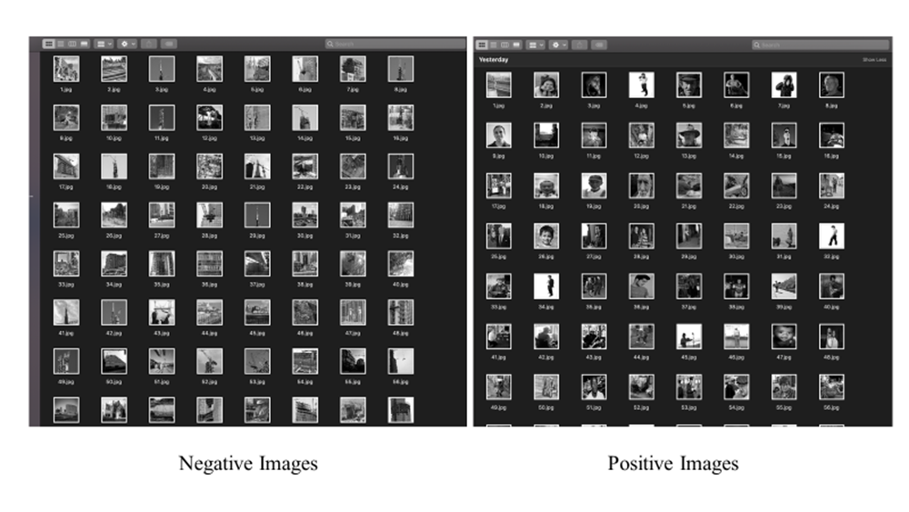

Slide 25
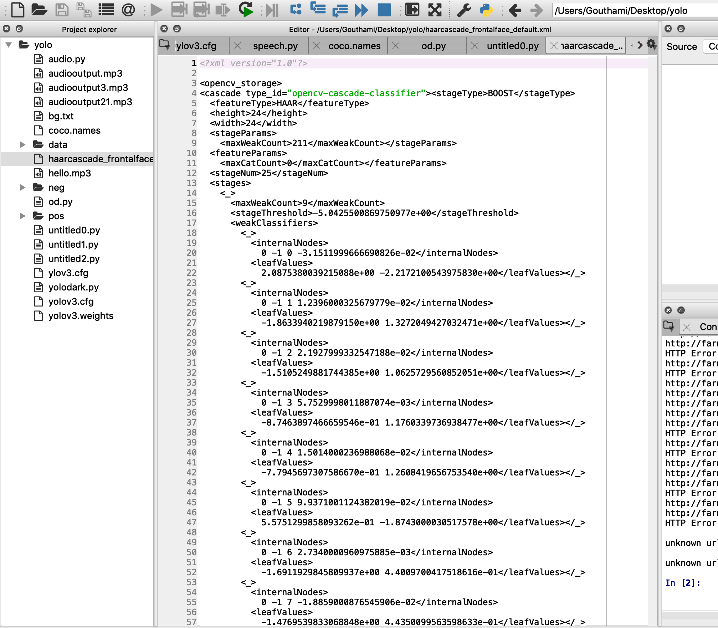
opencv_traincascade -data haarcascade_frontalface_default.xml -pos pos.txt -bg bg.txt -numPos 800 -numNeg 400 -numStages 10 -w 100 -h 100

Slide 26
Step 6 : a) Reading out Dynamic labels
Google Text To Speech engine was used to read out the labels. It stores the label values as an mp3 file.
Labels are appended to the set in the order they are detected dynamically.
Pygame is a Python wrapper module for the multimedia library to play Audio files.

Slide 27
b) Raspberry Pi Integration
Multiple packages like OpenCV, Gtts, SSH, had to be installed.
The object detection program was run using Python IDE, Thonny
Pi was accessed using putty , Xming Server, Windows Remote Control
Camera was interfaced to the pi
For audio output, a speaker was connected

Slide 28
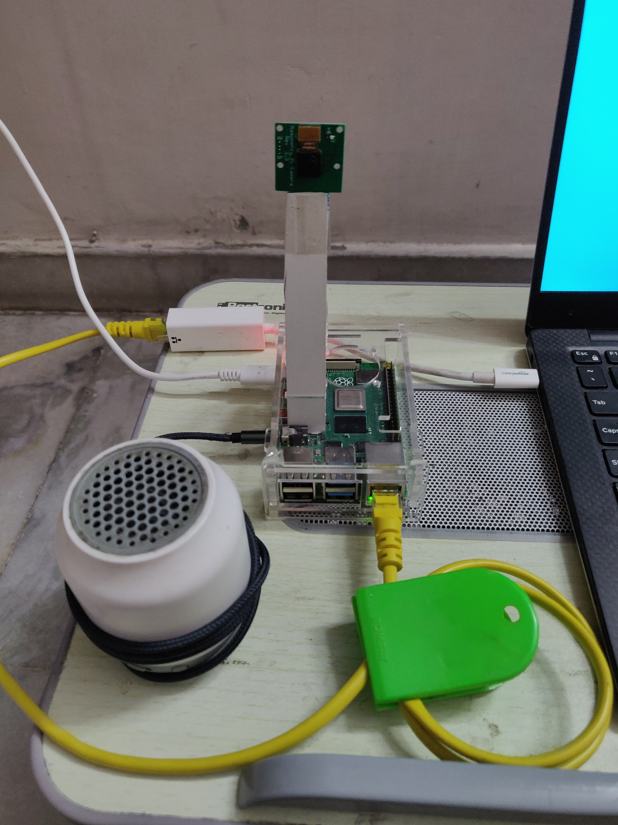
Raspberry Pi complete Setup

Slide 29
RESULTS AND OUTPUT

Slide 30
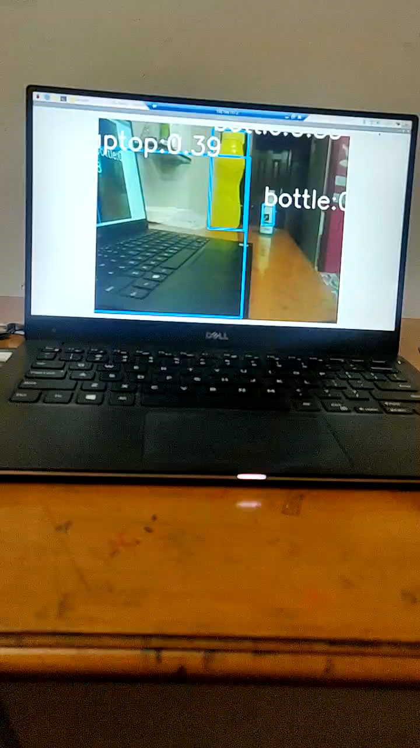

Slide 31
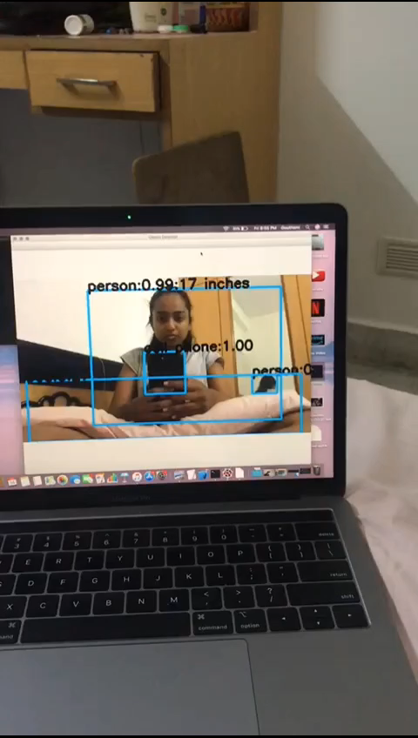

Slide 32
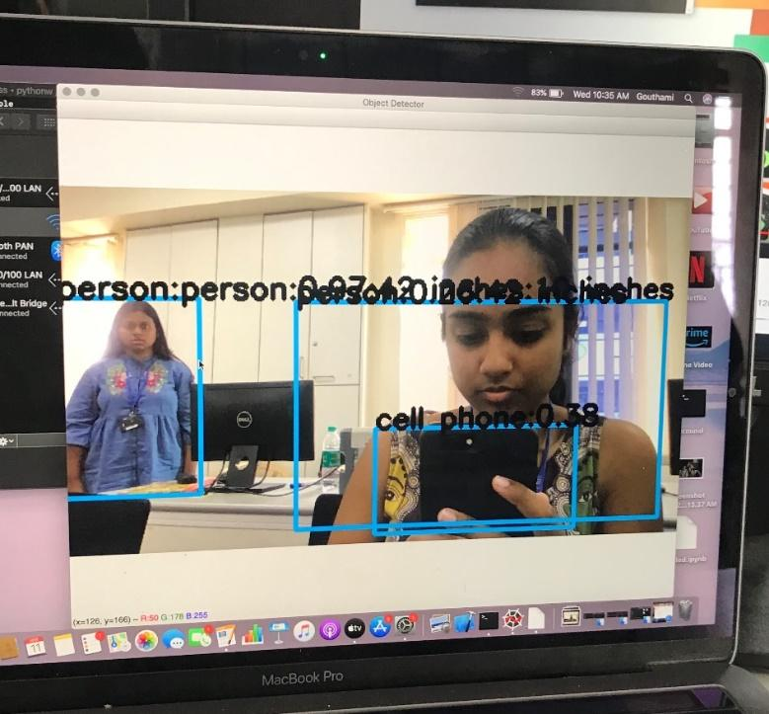
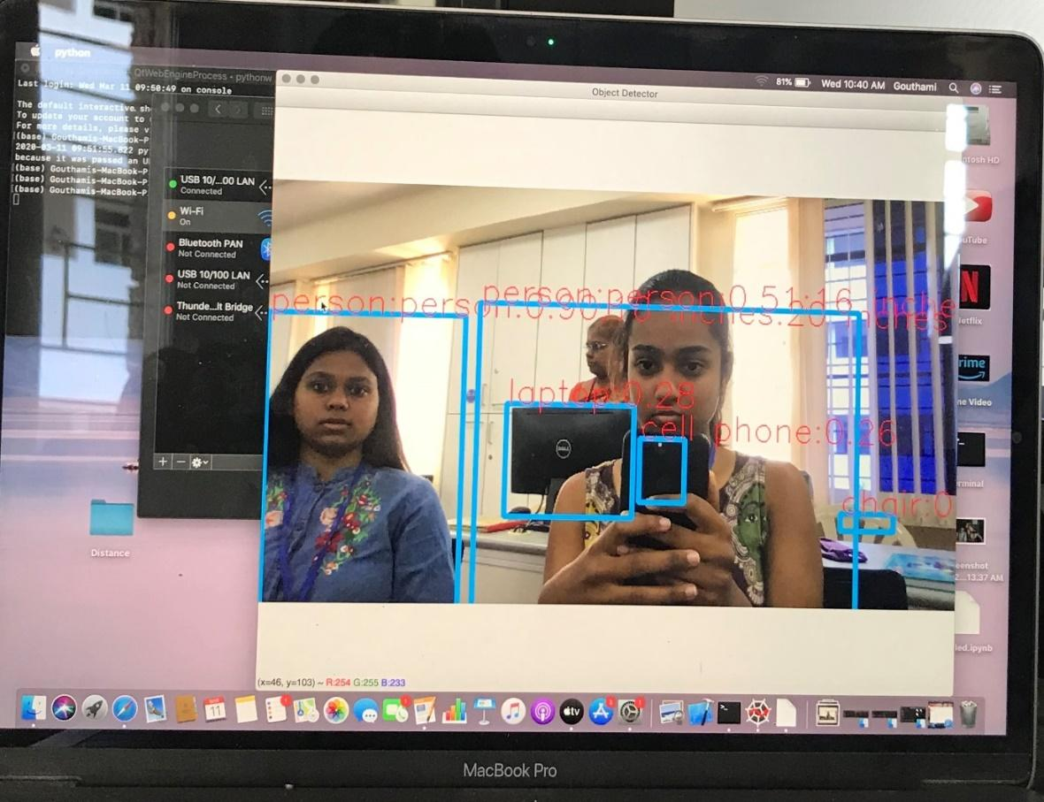
the distances for two humans detected were 42 inches and 11 inches respectively.
the distances for humans were detected and other objects like monitor(laptop) , phone and chair were identified

Slide 33
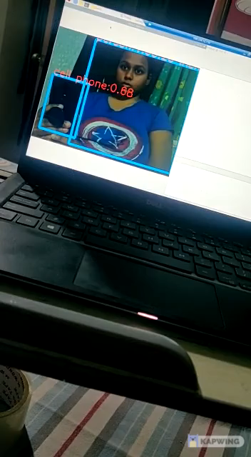

Slide 34
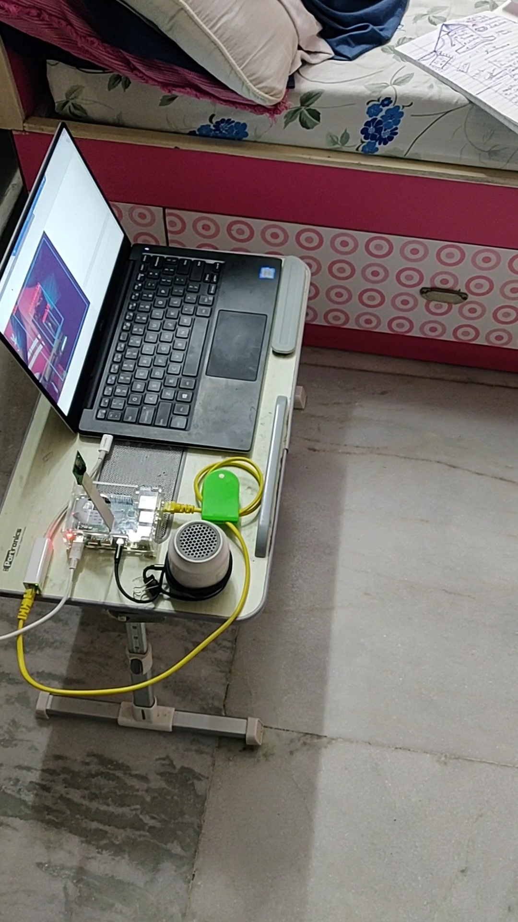

Slide 35
APPLICATIONS
Though this project is primarily developed to aid visually disabled people to aid in crash free motion, it can have various other applications such as:
Self-driving cars
Video surveillance
Pedestrian detection
Face detection
Tracking objects etc

Slide 36
CONCLUSION
After testing under different circumstances, the objects were accurately identified by the model developed using YOLO . The following two points have to be looked into under future scope
An efficient method for the distance calculation for multiple objects monocular camera is yet to be formulated. 3D reconstruction which is under research ,can be used to calculate the distance for multiple objects.
The processing of frames on the Raspberry Pi is less compared to that of a CPU and GPU. This makes it very slow. A method to increase the speed of processing of the frames must be found out.

Slide 37
PAPER PUBLICATION
The paper was accepted by the Board of Referees (BoR) of ‘Blue Eyes Intelligence Engineering and Sciences Publication (BEIESP)’ for publication in the ‘International Journal of Engineering and Advanced Technology (IJEAT)’ and was published at Volume-9 Issue-4, April 2020 in Regular Issue on 30 April 2020. It is available live at http://www.ijeat.org/download/volume-9-issue-4/
This paper was uploaded in the database of Web of Science (Publons), Elsevier (Mendeley), KUDOS and CrossRef
DOI link: https://www.ijeat.org/wp-content/uploads/papers/v9i4/D7868049420.pdf

Slide 38
THANK YOU

